Slide 1


Air Traffic scaling, delay- analysis and prediction using pyspark on Hadoop Cluster
Mohammed Zoher Guniem
Megh Raj Upreti
NAME, title

Slide 2
- Scaling our dataset with respect to UTC time and geographic position at flight. - Scaled data is served to the user by providing a time interval and the geographic coordinates of the Lower Left Corner, LLC and Upper Right Corner, URC. - There exist a huge need to provide realistic data for air traffic analyzation and simulation. Scaling big datasets in an efficient way is essential for these modern air traffic application.
Scaling and simulation, USE CASE - I

Slide 3
- An arrangement of some basic statistics of the 5 different delays into categories extracted from other target columns like origin and destination etc… - The output is used to feed a Power BI model which helps the user to easily view and analyze the distribution of delays over any target category. - Categories can also be merged together of one or more csv columns, like route between states, citites or airports. - This improves the speed of the power BI model and the overall experience of the user, because the pyspark script can be configured with more target delay analysis using a json config file.
Delay Analysis, USE CASE - II

Slide 4
Delay prediction, USE CASE III

Slide 5

Related Work
Scaling and simulation
Second level
Third level
Delay analysis
Second level
Third level
Delay Prediction
Second level
Third level
Dette bildet av Ukjent forfatter er lisensiert under CC BY-SA

Slide 6
- Main dataset Open Source CSV files from the Bureau of Transportation Statistics which includes all of the domestic flights in the USA from 2019. Size can vary according to the need, In our case about 1.88 GB. - Support dataset In order to include airport’s latitude and longitude in addition to time zone information, We use a support dataset from the same source which is about 1,17 MB in size.
Dataset(s)

Slide 7
Dataset(s), strengths and weaknesses
Strenghts
Provides detailed information about the flight route from taxing into the runway until final arrival at the terminal.
Reasons for flight delays are given in 5 clear and reasonable categories.
Support dataset is available to assist special need like difference between local time and UTC time.
Weaknesses
Clock time like wheels off and wheels on is given in local time, which makes it essential to convert these into UTC times.
Delay categories are numeric and needs to be converted into suitable interval categories for prediction.
No airport coordinates included in the main dataset.

Slide 8
Scaling and simulation, Implementation and challanges
Preparing the data
Unclean data
No wheels off, wheels on, or airtime. Due to cancelation or other unknow reason.
No coordinates of origin and destination airports, and time is given in local clock
We had to use support data from the same provider to get geographic coordinates and convert local time to UTC time.
Scaling
Wheels off and/or wheels on before/after target time interval
Solved by processing data from yesterday, today and tomorrow.
Calculating the flight position at each minute
Relayed on Great circle calculations using python basemap library.
by using the given airtime value to get position at each minute with average speed.
Simualtion
Designing an example of a client application with pure python
By using JSON data provided by scaling step above on a daily basis,
we can run simulations in between requested time interval and geographic area in an efficient and fast approach.
Designing an example of a client application with pure python
By checking if origin and/or destination airports are inside the requested simulation area,
we can determine wheather the flight is within, outgoing, incoming or just passing over the request simulation area.

Slide 9
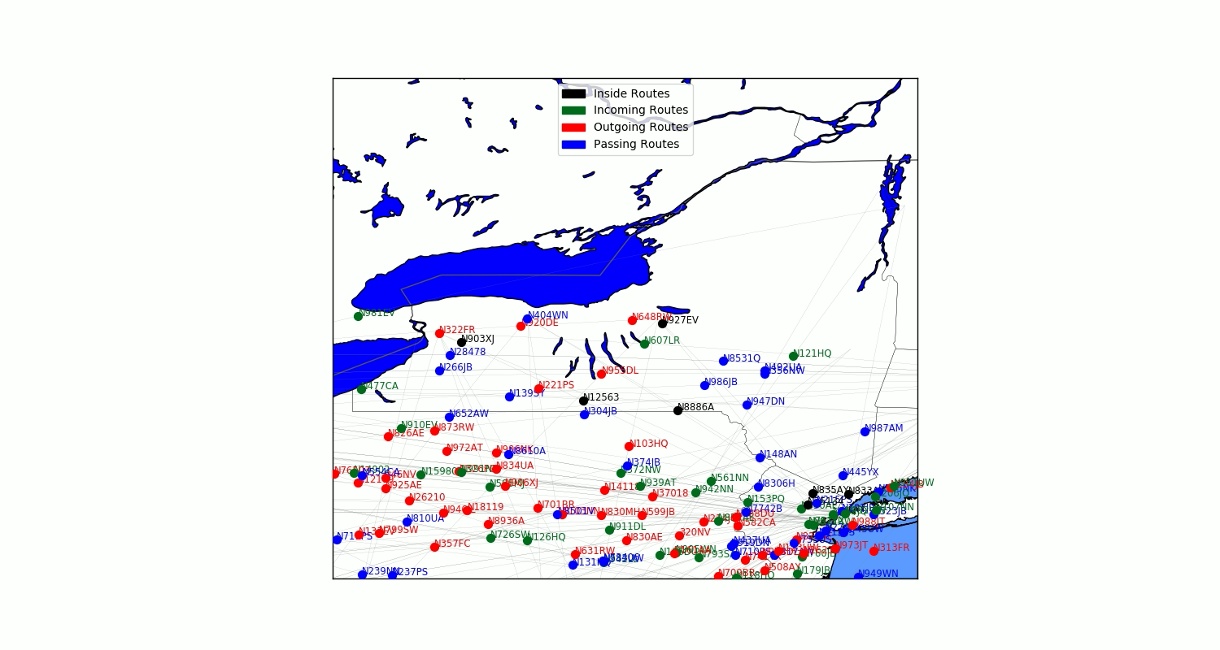
Simulation over New York State, between 18 and 18:30 at 10.04.2019

Slide 10

Delay Analysis, Implementation and challanges
Power BI Visualization
PySpark imporves the performance of Power BI
Although Power BI is capable of performing all basic statistics calculations, loading a dataset of a very big size to power BI will harm the speed and user experience of its useful visualization tools.
Grouping delays and its statistics
Identifying the 5 different delays as target
Weather delay, NAS delay, Security delay, Carrier Delay and Late aircraft delay, the sum of all delays is also included in case more than one delay is caused on the same flight.
It is interesting to know sum, average, minimum and maximum of all 5 delays
Mode and median are often equals 0 because most flights has no delay. Minimum is also equals to 0 but we calculated anyway since it’s crucial to know in case the target is experiencing a certain delay as minimum.
Calculating the statistics
User provides feature columns like origin and/or destination in single or grouped matter,
The delay statistics are then grouped and calculated according to the provided feature column(s).
User Input and Output to Power BI
User Input
User uses a JSON config file to configure one or more calculation with as many feature columns as wanted.
Output
The PySpark script outputs its result calculation in a csv format file, and this file can be used to feed the Power BI model.

Slide 11
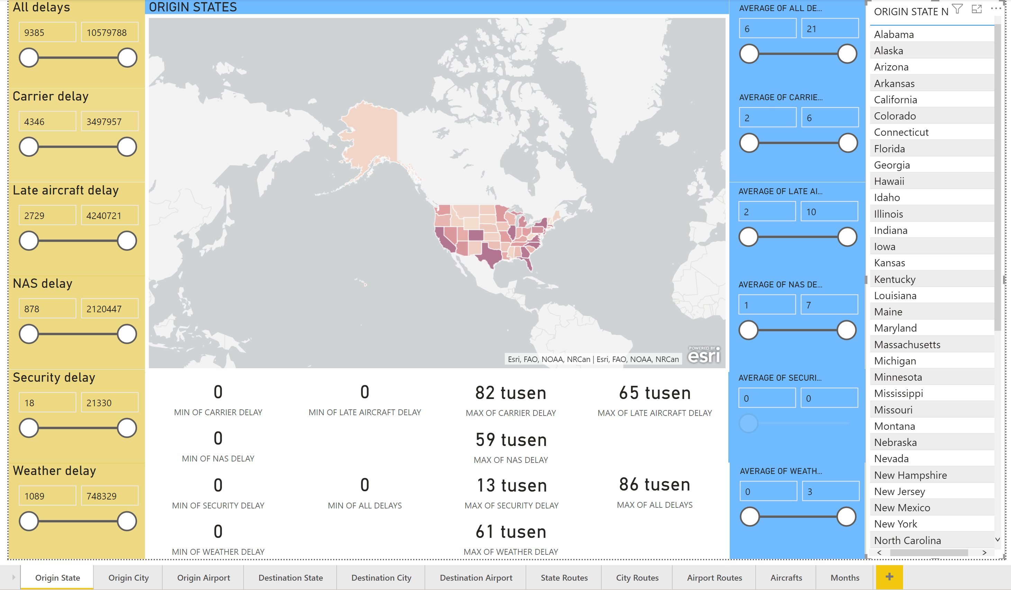
Power BI Model

Slide 12
Delay Prediction, Implementation and challanges

Slide 13
Summary
Scaling and simulation
Preparing the data:
One run on Hadoop cluster, increases the size of dataset to 2,5 GB. Takes about 15 minutes to finish.
Scaling:
One run every day on Hadoop cluster to scale data for the day after.
Outputs 2 json files with size of 200 MB in total,
The first file is for route information and the second is for position of each route at each minute in unix time.
Simulation:
Runs by user on client-side.
Generates a .gif picture and .avi video.
Shows the different type of aircrafts and movement of air traffic across the requested area in the requested time limits.
Delay Analysis
Script design and execution:
Runs when requested by user on Hadoop cluster, who uses a json file to configure the script. Takes about 15 minutes to run,
Takes about 15 minutes to finish 10 singles and 1 merged configurable analysis.
Input and output:
The entire dataset without any support data is loaded into memory at start, output a file of nearly 5 MB for the analysis mentioned above.
The output csv files are then loaded into Power BI for visualization.
Delay prediction
Second level
Third level

Slide 14


Thanks
Project code, documentation, Power BI model and examples will soon be available in report and on Github repository.

